Slide 1
Predict Used Car Values
Yang Gao, Yifei Li, Yuankai Wang,
Zhuochen Liu, Hao Yang
Notes:
咕咕咕咕咕咕咕咕咕

Slide 2
Introduction:
Purpose:
When people want to sell their cars, they want to have an idea about how much their cars worth.
Notes:
A natural approach is to find several similar used cars on the website and look at their price. Unfortunately, since a car’s price can be affected by many factors, it is time-consuming to find similar cars on the internet. Therefore, we would like to build a model for used car prices. Eventually, we found a proper dataset for used car price on Kaggle [1]. The dataset contains various features about used cars, including (but not limited to) the car model, car maker, mileage, and color. Since the dataset has a reasonable size (contains information for more than 200k cars) and covers a lot of features, we decide that this dataset is ideal for training our model.

Slide 3
Preprocessing
Delete:
useless columns
columns with duplicate meanings
already be one-hot encoded
empty values
meaningless outliers
We finally got a dataset of 96,582 rows and 97 columns.
Notes:
When we downloaded the data and looked over it, we found out that the data is not well organized. We need to preprocess it to make it suitable for training.
Some of the columns are useless. For example, the start time and end times are with the same value. The VIN number does not help on predicting the price. These columns are not useful features of a car, so we also removed them.
Some of the columns have the same meaning, such as the year of production and the car age, so only one of them need to be reserved.
Some of the features have both a raw classification value column and one-hot encoded columns, so we removed the columns for raw values.
We also removed rows that have many missing data.
Some of the rows contain outliers. For example, one of the cars with a poor condition has a price of 3,000,000,000.
To get rid of those outliers, we went through the whole dataset using the filter function of excel worksheet and polished the data.
We finally got a dataset of 96,582 rows and 97 columns.

Slide 4
Preprocessing (cont)
Standardize
One-hot encoding
Training vs Validation vs Testing
Notes:
After we load the data using python, we picked out the columns that need to be standardized, which include car age, mileage, the number of parameters available, and the number of features.
We then one-hot encoded the data that had not been encoded yet and finally got 1106 columns.
Before we trained the model, we split the dataset into training and testing data with a ratio of 80% to 20%. For training data, we split it into training and validation sets again with a ratio of 80% to 20%.

Slide 5
Regression Approach
Our first approach is to train a network that can predict accurate prices.
We tried to use Regression Model for this problem.
First attempt: Trained a single layer model and use its accuracy as baseline
Notes:
Our first approach is to train a network that can predict accurate prices. We computed the standard deviation of the price and set it as the baseline. Then, we trained the network using a simple model using Keras with Tensorflow back end. The model had one layer and applied early stopping (patience is set to 3). Initially, we wanted to set the loss of this model as the baseline. However, the training loss and the validation loss are both worse than the standard deviation (shown in picture 1). Even though the loss keeps decreasing, it is not a reasonable model since it does not get better than standard deviation even after 100 epochs. Thus, we decided to keep the standard deviation as the baseline for our future models.

Slide 6
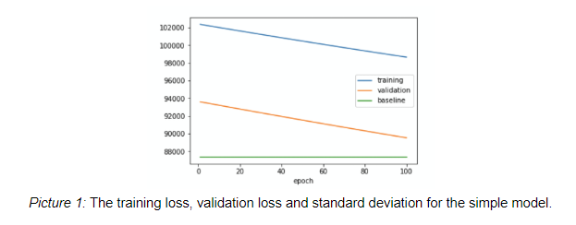
Notes:
Our first approach is to train a network that can predict accurate prices. We computed the standard deviation of the price and set it as the baseline. Then, we trained the network using a simple model using Keras with Tensorflow back end. The model had one layer and applied early stopping (patience is set to 3). Initially, we wanted to set the loss of this model as the baseline. However, the training loss and the validation loss are both worse than the standard deviation (shown in picture 1). Even though the loss keeps decreasing, it is not a reasonable model since it does not get better than standard deviation even after 100 epochs. Thus, we decided to keep the standard deviation as the baseline for our future models.

Slide 7
Regression Approach(cont)
However, the first attempt result in error that is larger than predicting using Standard Deviation.
Second attempt: Trained a five layer model with ReLU and early stopping
Outcome: Much better than standard deviation
Notes:
Then, we constructed a more sophisticated model. The model has five hidden layers, and for each layer, there are 10000, 1000, 100, 10 and 1 nodes. To prevent the layers from collapsing, we applied ReLU activation to each layer. We also included early stopping for the model (with patience equals to 3). The network stopped training due to early stopping after 13 epochs. This time, we found that the training loss and validation loss are both smaller than baseline (shown in picture 2). Therefore, we kept this model as the best regression model we trained.

Slide 8
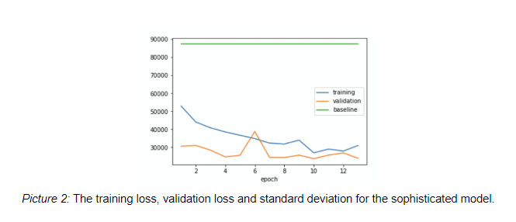
Notes:
Then, we constructed a more sophisticated model. The model has five hidden layers, and for each layer, there are 10000, 1000, 100, 10 and 1 nodes. To prevent the layers from collapsing, we applied ReLU activation to each layer. We also included early stopping for the model (with patience equals to 3). The network stopped training due to early stopping after 13 epochs. This time, we found that the training loss and validation loss are both smaller than baseline (shown in picture 2). Therefore, we kept this model as the best regression model we trained.

Slide 9
Classification Approach
Limitation of Regression Model
Divided cars into six categories according to their prices and build a classification model
First attempt: Set categories such that each category has equal number of cars.
Train model against a small part of data and drive the training error to 0
Notes:
We feel that it is hard to determine the exact value of a used car, and because the price of a car is a large number, a small prediction error can lead to a large loss. Besides, we are more interested in an approximate price range of used cars. Therefore, we decide to divide cars into six categories according to their prices and build a classification model.
Our first categorization method is to sort the dataset by price and then evenly divide it into six parts, and use them to train our classification model. We decided to use 1% of the original dataset to test our models since we do not want to waste too much time training an incorrect model with a huge dataset. To test if a model it correct, we just check if it can drive training error to 0. After several attempts, we got a working model.

Slide 10
Classification Approach
However, we feel that the price of car is not uniformly distributed
Second attempt: Manually set the categories based on experience and knowledge of cars.
ReLU between hidden layers
Dropout regularization
Notes:
However, we then realized that the price of a car is not uniformly distributed, so we modified our method to set up price levels. The new categories are 0-4999, 5000-9999, 10000-19999, 20000-49999, 50000-99999, and greater or equal to 100000. We believe our new price levels can better represent the value of a car.
Our final model consists of 5 hidden layers with “ReLU” activation layers in between. The dropout regularization is applied between each pair of layers with a dropout rate of 0.3. The model achieves a validation accuracy of 81.7%, and the accuracy for predicting the test data is 80.7%, which we feel is pretty good.

Slide 11
Results (Regression)
Error rate less than 10%: 45%
Error rate less than 20%: 74%
Maximun error rate: >1300%
Notes:
For our regression model, since it is hard to compute the exact price of the car, we measured our regression model’s accuracy based on the percentage difference between the predicted price and the actual price. After using the sophisticated model to predict the price for cars in the testing set, we found out that there are around 45% of the predicted values have an error less than 10% and around 74% of the predicted values have an error less than 20%. We also noticed that for some cars, the error rate can be up to 1300%. Due to the poor performance of this regression model, we eventually decided to abandon this model and take the other approach.
We measure our accuracy through not only calculating the ratio of the correctly predicted amount to the total amount of data, but also counting the number of outputs whose classification error is more than two levels away from the actual price level (for example, classified as the second price interval but should actually be the fifth). Here is the final result:
With a total of 19316 pieces of test data, we got:
Number of correct predictions: 15587
Number of incorrect predictions: 3729
Number of incorrect predictions differ by more than 2 levels: 76

Slide 12
Results (Classification)
Total number of testing data: 19316
Number of correct predictions: 15587 Number of incorrect predictions: 3729 Differ by more than 2 levels: 76
Notes:
For our regression model, since it is hard to compute the exact price of the car, we measured our regression model’s accuracy based on the percentage difference between the predicted price and the actual price. After using the sophisticated model to predict the price for cars in the testing set, we found out that there are around 45% of the predicted values have an error less than 10% and around 74% of the predicted values have an error less than 20%. We also noticed that for some cars, the error rate can be up to 1300%. Due to the poor performance of this regression model, we eventually decided to abandon this model and take the other approach.
We measure our accuracy through not only calculating the ratio of the correctly predicted amount to the total amount of data, but also counting the number of outputs whose classification error is more than two levels away from the actual price level (for example, classified as the second price interval but should actually be the fifth). Here is the final result:
With a total of 19316 pieces of test data, we got:
Number of correct predictions: 15587
Number of incorrect predictions: 3729
Number of incorrect predictions differ by more than 2 levels: 76

Slide 13
Conclusion
Accuracy:
Around 80%
Social Impact:
People can negotiate with dealers better with the model
Limitation and future development:
Data set is from Poland
Need more reliable data if we want to apply to other countries.
Notes:
The highest accuracy we have achieved is around 80%. We think this is an acceptable result for our problem. Having a good estimation of the used car price gives people an expectation of how much money they should spend or receive when they buy or sell a used car, which brings them more advantages when they negotiate with dealers or other individuals. The dataset we used is from Poland, but we believe that if we want to estimate the price for used cars in other regions, this model will be suitable as well. The only thing we need to do is to collect more reliable data from the society.

Slide 14
Any questions?
Notes:
没有的

